Slide 1
Module5 Understanding Fixed-Income Risk and Return
MONEY DURATION AND THE PRICE VALUE OF A BASIS POINT
The money duration of a bond is a measure of the price change in units of the currency in which the bond is denominated.
In the United States, money duration is commonly called “dollar duration.”
MoneyDur = AnnModDur * PV^{Full}
ΔPVFull ≈ –MoneyDur × Δyield

Slide 2
Module5 Understanding Fixed-Income Risk and Return
Consider the 6% semiannual coupon payment bond that matures on 14 February 2023 and is priced to yield 6.00% for settlement on 11 April 2019. The full price of the bond is 100.940423 per 100 of par value, and the annual modified duration is 3.3561. Suppose that a Nairobi based life insurance company has a position in the bond for a par value of KES100,000,000. The market value of the investment is KES 100,940,423.
Money duration = 3.3561*100,940,423=338,766,154
If the yield-to-maturity rises by 100 bps—from 6.00% to 7.00%
Approximately expected loss = - 0.01 * 338,766,154 = -3,387,662

Slide 3

Module5 Understanding Fixed-Income Risk and Return
The price value of a basis point (or PVBP) is an estimate of the change in the full bond price given a 1 bp change in the yield-to-maturity.
PVBP = $\frac{\left(PV−\right)−(PV+)}{2}$
In the United States, it is commonly called the “DV01,” or the “dollar value of a 01.”

Slide 4
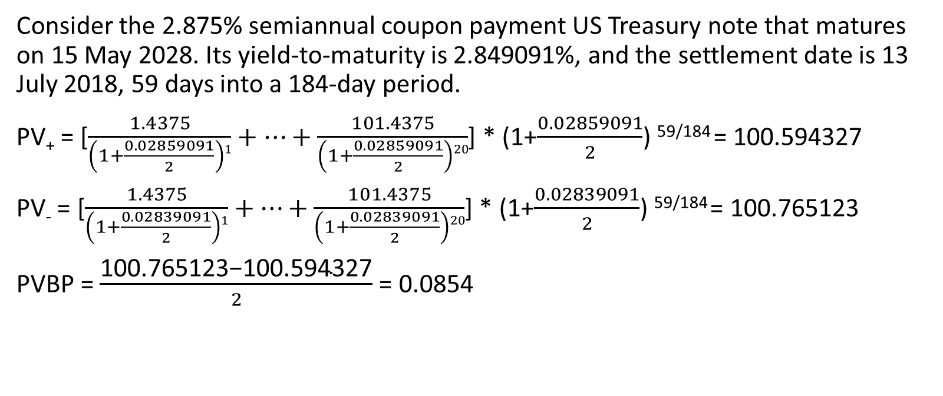
Module5 Understanding Fixed-Income Risk and Return
Consider the 2.875% semiannual coupon payment US Treasury note that matures on 15 May 2028. Its yield-to-maturity is 2.849091%, and the settlement date is 13 July 2018, 59 days into a 184-day period.
PV₊ = [$\frac{1.4375}{\left(1+\frac{0.02859091}{2}\right)1}+…+\frac{101.4375}{\left(1+\frac{0.02859091}{2}\right)20}$] * (1+$\frac{0.02859091}{2}$) ^{59/184} = 100.594327
PV₋ = [$\frac{1.4375}{\left(1+\frac{0.02839091}{2}\right)1}+…+\frac{101.4375}{\left(1+\frac{0.02839091}{2}\right)20}$] * (1+$\frac{0.02839091}{2}$) ^{59/184} = 100.765123
PVBP = $\frac{\text{100.765123−100.594327}}{2}$ = 0.0854

Slide 5
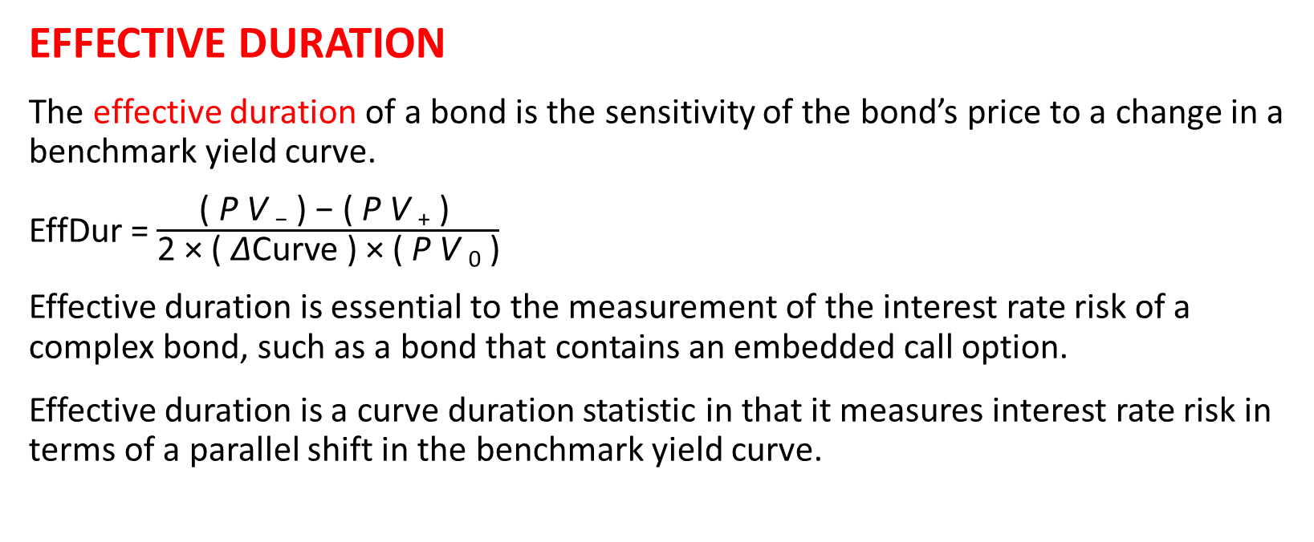
Module5 Understanding Fixed-Income Risk and Return
EFFECTIVE DURATION
The effective duration of a bond is the sensitivity of the bond’s price to a change in a benchmark yield curve.
EffDur = $\frac{\text{( }\text{P} \text{V} \text{−}\text{ ) − ( }\text{P} \text{V} \text{+}\text{ ) }}{\text{2 × ( }\text{Δ}\text{Curve}\text{ ) × ( }\text{P} \text{V} \text{0}\text{ )}}$
Effective duration is essential to the measurement of the interest rate risk of a complex bond, such as a bond that contains an embedded call option.
Effective duration is a curve duration statistic in that it measures interest rate risk in terms of a parallel shift in the benchmark yield curve.

Slide 6

Module5 Understanding Fixed-Income Risk and Return
Suppose that the full price of a callable bond is 101.060489 per 100 of par value. Suppose that when the government par curve is raised and lowered by 25 bps, the new full prices for the callable bond from the model are 99.050120 and 102.890738, respectively.
EffDur = $\frac{102.890738−99.050120}{2∗0.0025∗101.060489}$ = 7.6006

Slide 7
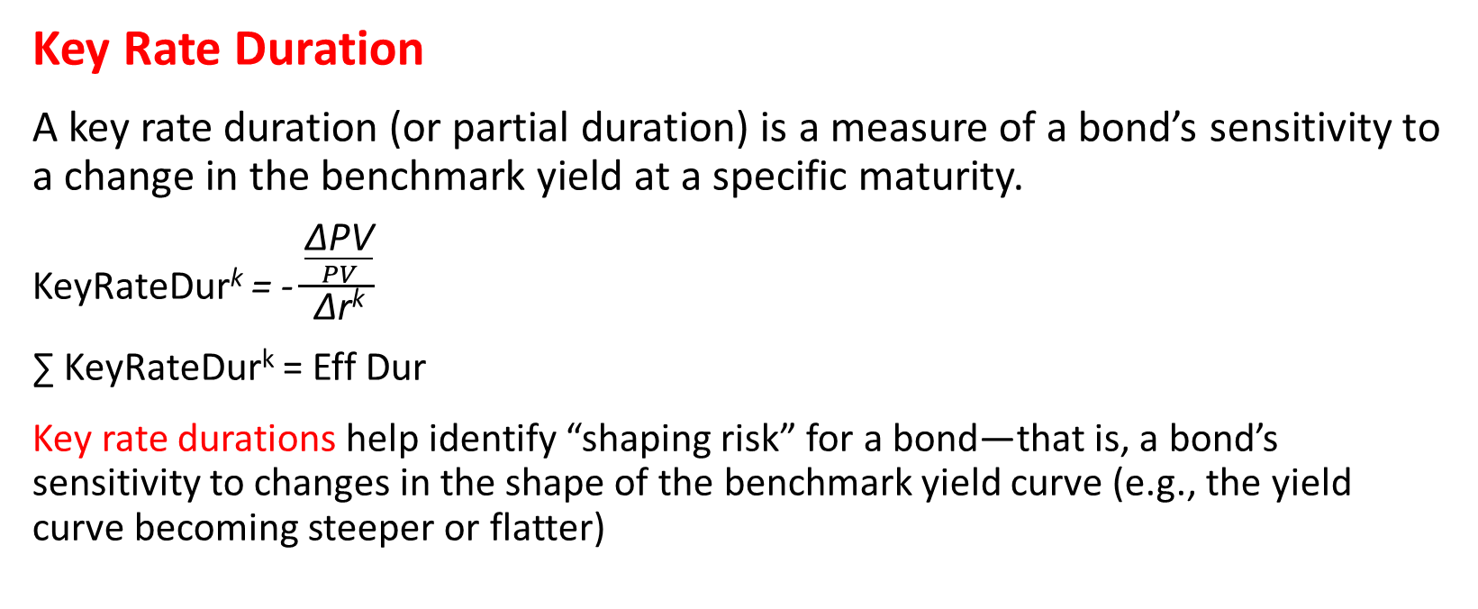
Module5 Understanding Fixed-Income Risk and Return
Key Rate Duration
A key rate duration (or partial duration) is a measure of a bond’s sensitivity to a change in the benchmark yield at a specific maturity.
KeyRateDur^{k} = - $\frac{\frac{\text{Δ}\text{PV}}{PV}}{\text{Δ}\text{r}\text{k}}$
∑ KeyRateDur^{k} = Eff Dur
Key rate durations help identify “shaping risk” for a bond—that is, a bond’s sensitivity to changes in the shape of the benchmark yield curve (e.g., the yield curve becoming steeper or flatter)

Slide 8
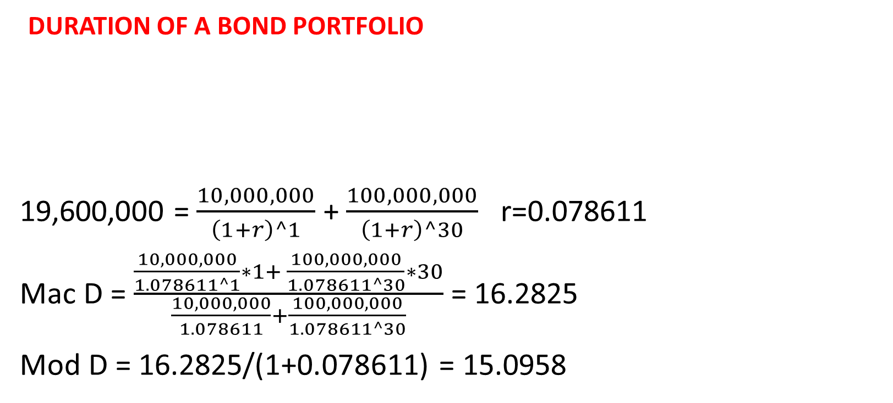
Module5 Understanding Fixed-Income Risk and Return
DURATION OF A BOND PORTFOLIO
19,600,000 = $\frac{10,000,000}{\left(1+r\right)^1}$ + $\frac{100,000,000}{\left(1+r\right)^30}$ r=0.078611
Mac D = $\frac{\frac{10,000,000}{1.078611^1}∗1+ \frac{100,000,000}{1.078611^30}∗30}{\frac{10,000,000}{1.078611}+\frac{100,000,000}{1.078611^30}}$ = 16.2825
Mod D = 16.2825/(1+0.078611) = 15.0958
Maturity | Price | Yield | Macaulay Duration | Modified Duration | Par value | Market value
1 | 98 | 2.0408% | 1 | 0.98 | 10,000,000 | 9,800,000
30 | 9.8 | 8.0503% | 30 | 27.765 | 100,000,000 | 9,800,000

